Slide 1

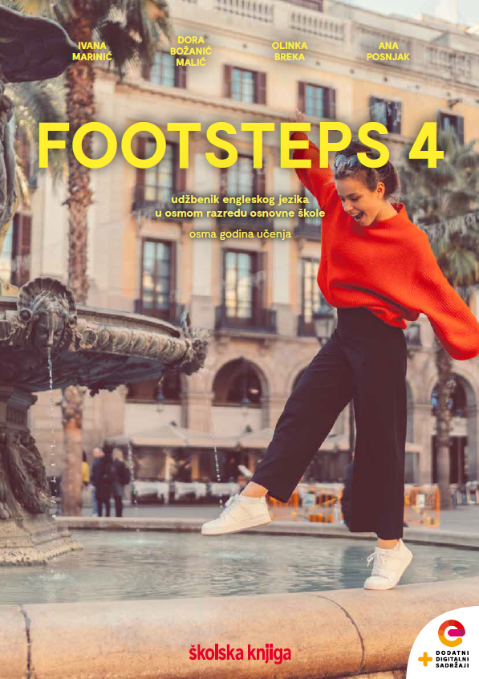

UNIT 5;
Tick tock
Lesson 4;
Jobs

Slide 2





Open your notebook and write down all the jobs you can name in English.
baker
doctor
nurse
JOBS

Slide 3
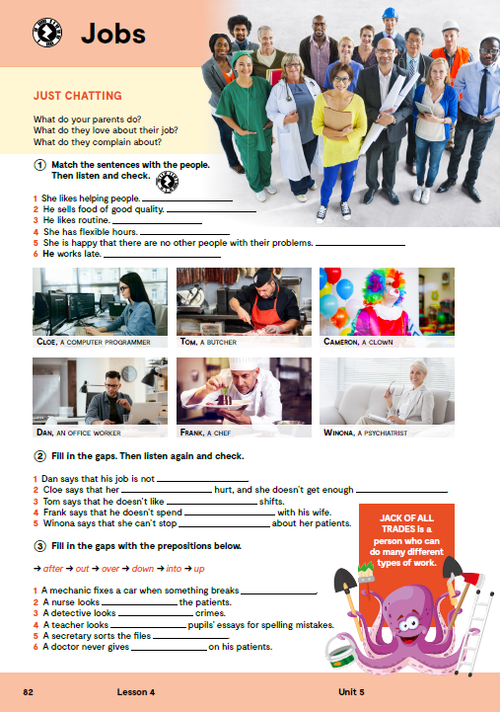
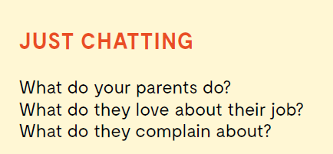
Do you know the meaning of these expressions?
What do your parents do?
What do they love about their job?
What do they complain about?
chef
butcher
psychiatrist
office worker
plumber
occupation
šef kuhinje, kuhar
mesar
psihijatar
uredski radnik
vodoinstalater
zanimanje

Slide 4

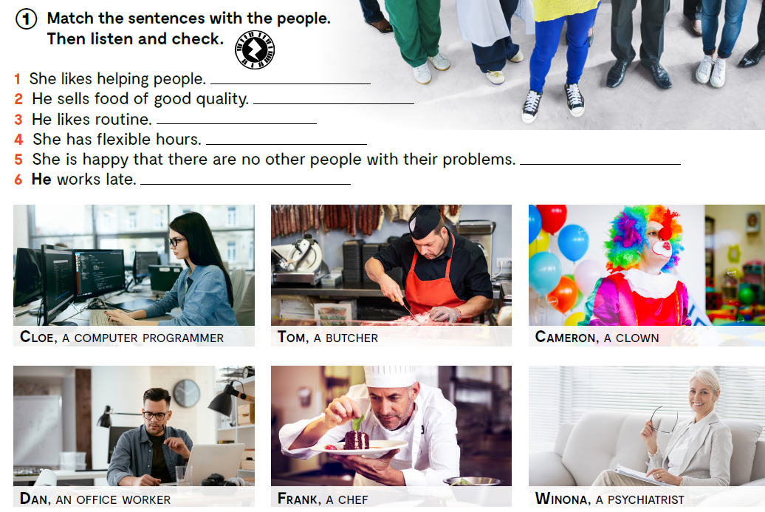

Match the sentences with the people. Then listen and check.
https://www.e-sfera.hr/dodatni-digitalni-sadrzaji/75de2870-3e8f-4662-8f14-893dcd06f285/assets/audio/17_unit_5__lesson_4__exercise_1_and_2.mp3
Winona
Tom
Dan
Cameron
Cloe
Frank

Slide 5
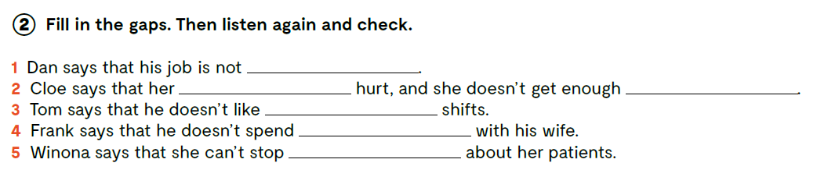
Fill in the gaps. Then listen again and check.
https://www.e-sfera.hr/dodatni-digitalni-sadrzaji/75de2870-3e8f-4662-8f14-893dcd06f285/assets/audio/17_unit_5__lesson_4__exercise_1_and_2.mp3
creative
eyes
sleep
afternoon
evenings
thinking

Slide 6

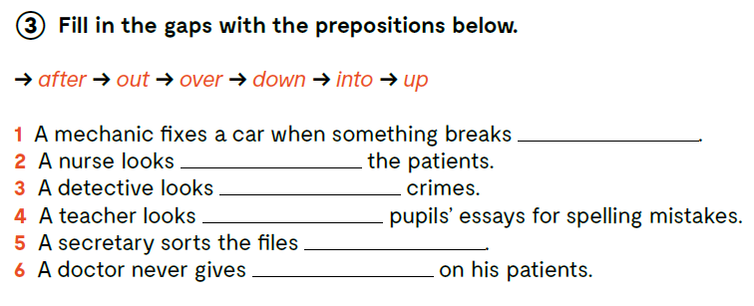
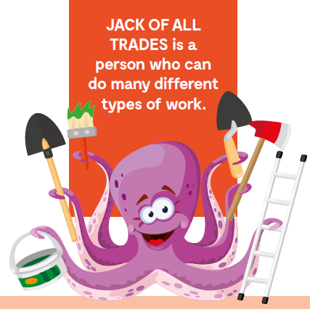
down
after
into
over
out
up

Slide 7
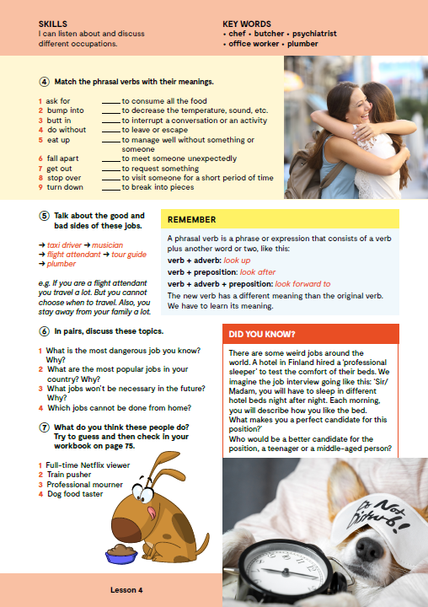
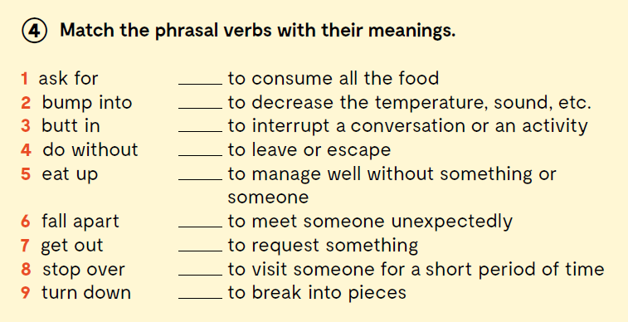
5
9
3
7
4
2
1
8
6

Slide 8

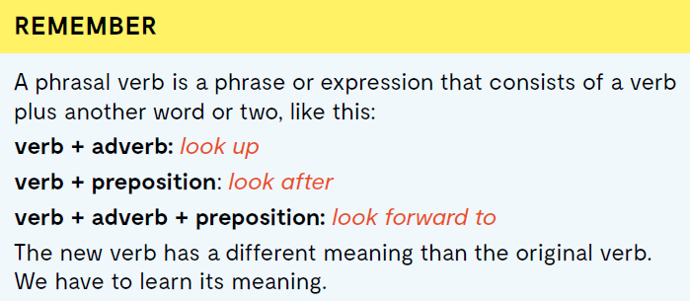

Slide 9

Frazalni glagol je fraza ili izraz koji se sastoji od glagola s dodatkom još jedne ili dvije riječi kao što su:
glagol + prilog: look up
glagol + prijedlog: look after
glagol + prilog + prijedlog: look forward to
Novi glagol ima značenje drugačije od izvornog glagola i njegovo novo značenje moramo naučiti.

Slide 10

Open the following link and then click on LEARN MORE!
https://www.e-sfera.hr/dodatni-digitalni-sadrzaji/75de2870-3e8f-4662-8f14-893dcd06f285/
Jobs nobody does any longer
Read the texts and do the tasks bellow the text.
Pročitaj tekstove i riješi zadatke ispod teksta.

Slide 11
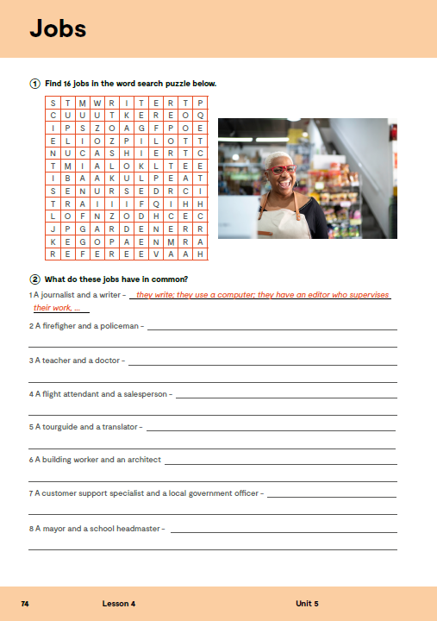
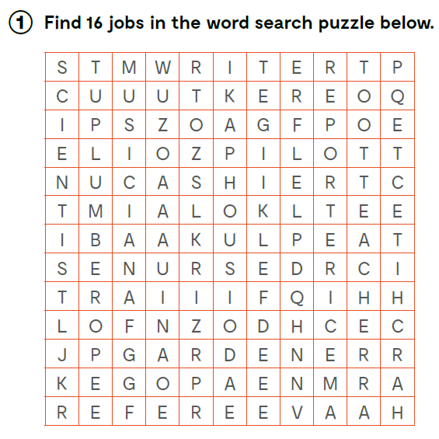

workbook, page 74.
Find 16 jobs in the word search puzzle below.

Slide 12
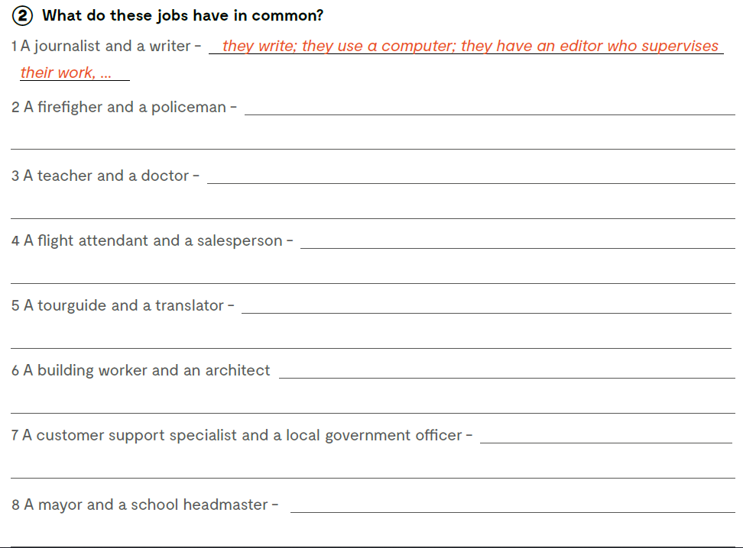
they wear a uniform; they help people in trouble; they drive in recognisable cars; you call them when there is an emergency…
they work with a lot of people; they need to be nice to people; they work in shifts…
they ask people if they can help them; they need to be nice to people…
What do these jobs have in common?
they speak a foreign language; they help people in translate from one language to another; they read a lot…
they need to know a lot about the building materials; they are good at calculating…
they have to use emails and talk on the phone a lot; they answer people’s questions; they have a desk and an office…
they are in charge of public money; they organise the work of others; they give public talks, …

Slide 13

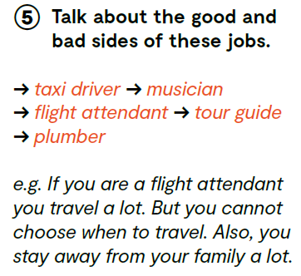
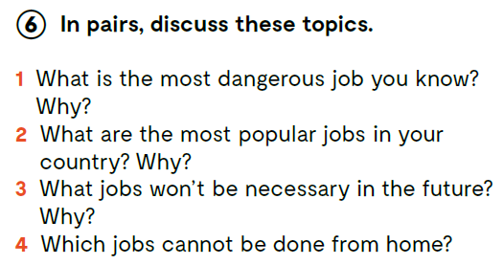

Slide 14

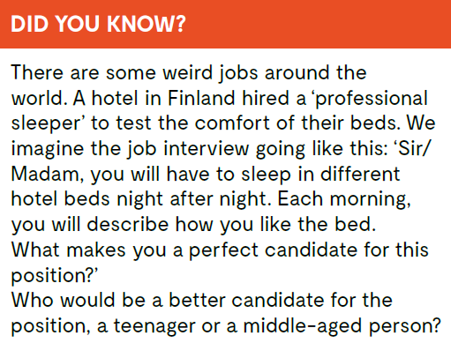
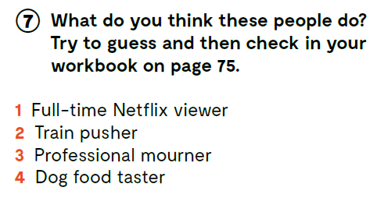

Slide 15
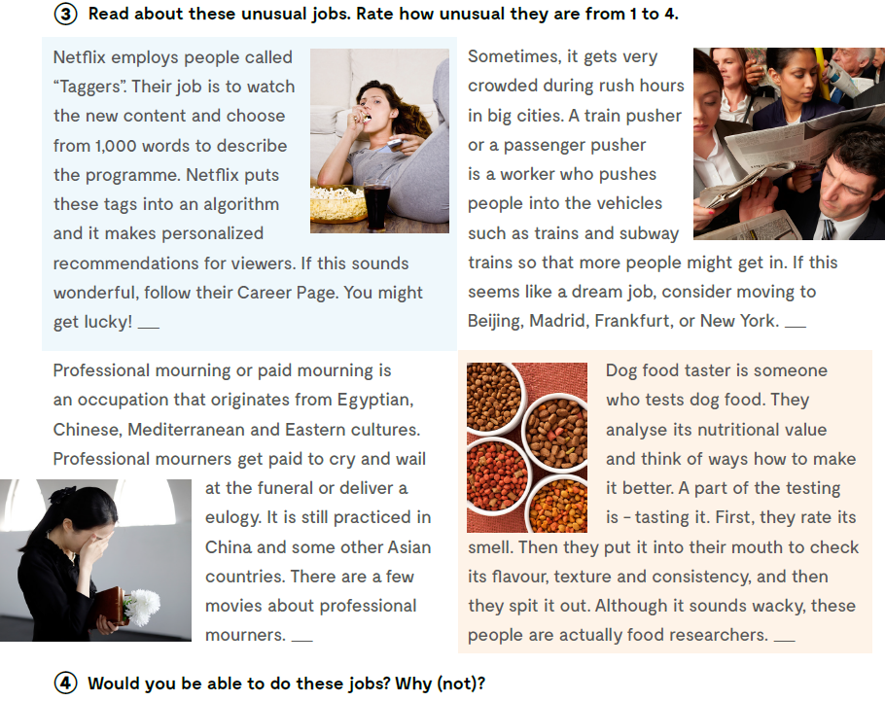
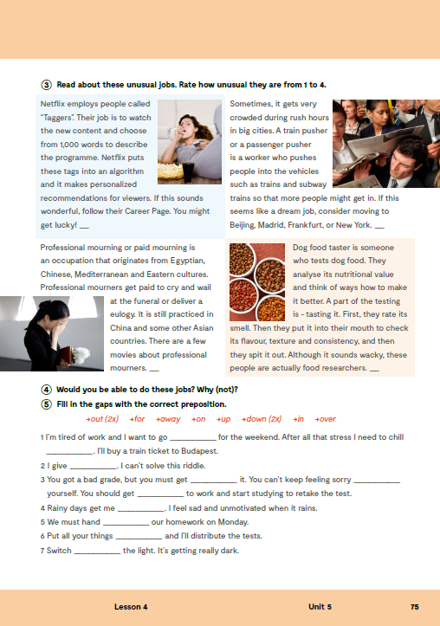
Open your exercise book, page 75.

Slide 16

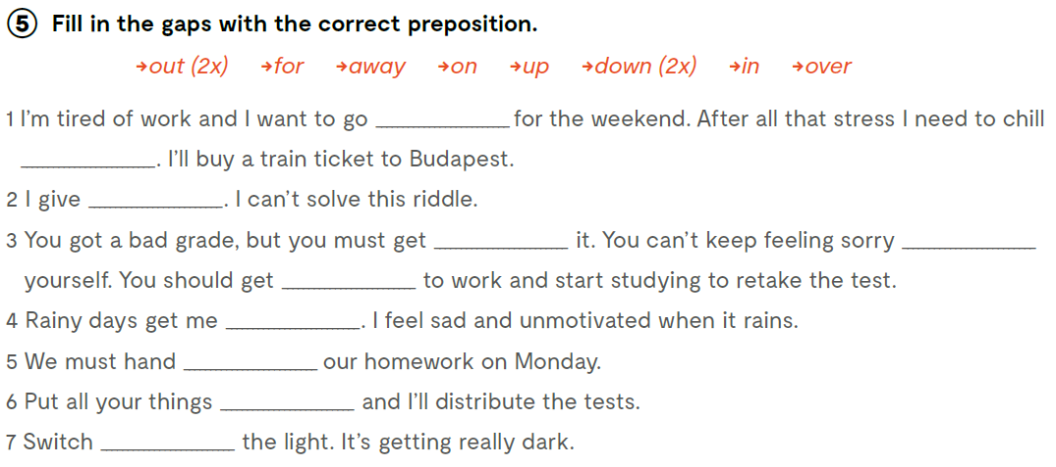
out
out
up
over
for
down
down
in
away
on
Check what you have learnt.
https://www.bookwidgets.com/play/YB93GYW
https://wordwall.net/play/13081/244/305

